Slide 1
Deep Learning
Week 5: Convolutional Neural Network-2
Marya Butt, PhD.
Researcher Data Driven Smart Society (DDSS)
BIG DATA, Computer Vision, Machine Learning
Faculty of Engineering Design and Computing
Mob: +31(0) 0611878759
E: marya.butt@Inholland.nl

Slide 2

Convolutional Neural Network

Slide 3

What is a Feature map? In CNNs, the input image is convolved with one or more filters to produce multiple feature maps. A feature map is responsible for detecting different visual features or patterns in the input.

Slide 4
Calculate Featuremap size
If a 131x131 image is convolved with a kernel of 3x3 size, having strides of 2 and no padding, calculate the size of the resultant feature map.
O= [ 131-3 ]
+ 1
= 65
2
So the feature map size will be 65x65

Slide 5
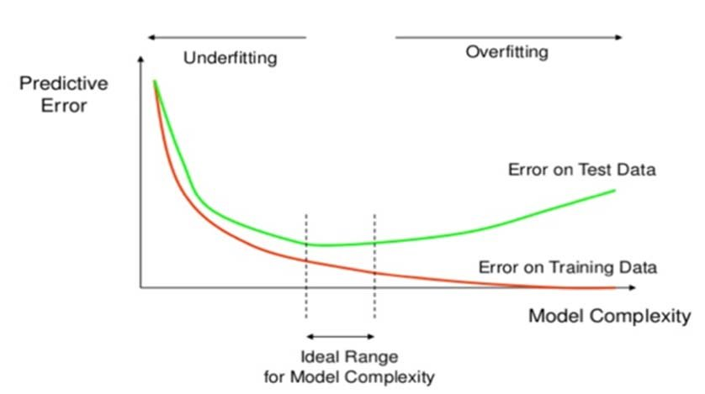
Understanding Learning Curves (diagnostic plots)

Slide 6
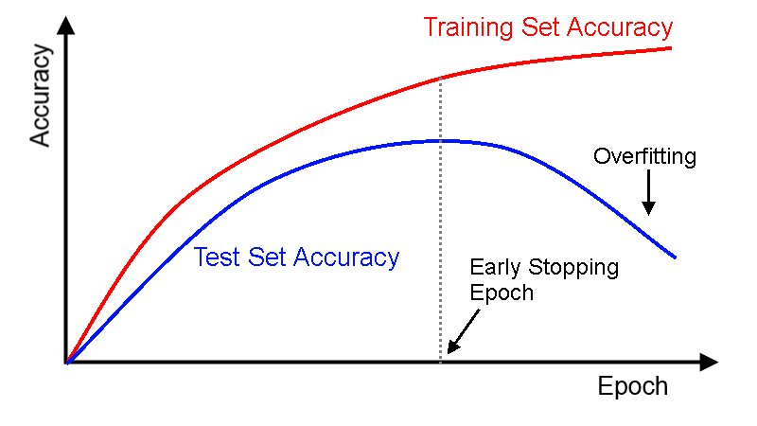
Understanding Learning Curves (diagnostic plots)

Slide 7
How to avoid Overfitting?

Slide 8
a) EarlyStopping
EarlyStopping(monitor=’val_loss’, verbose=1)
Often, the first sign of no improvement may not be the best time to stop training. This is because the model may get slightly worse before getting much better. We can account for this by adding a delay to the trigger in terms of the number of epochs on which we would like to see no improvement. This can be done by setting the “patience” argument.
EarlyStopping(monitor=’val_loss’, mode=’min’, verbose=1, patience=50)
The exact amount of patience will vary between models and problems. A rule of thumb is to make it 10% of number of epoch.
Read more: https://medium.com/zero-equals-false/early-stopping-to-avoid-overfitting-in-neural-network-keras-b68c96ed05d9

Slide 9
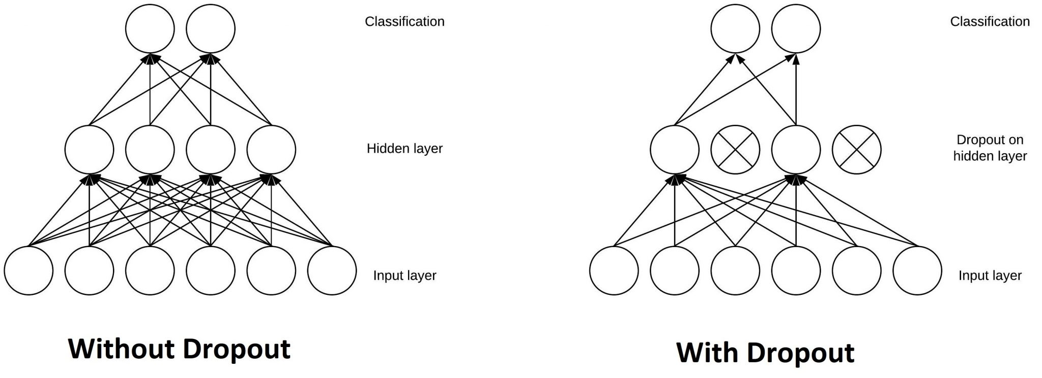
Dropout randomly deactivates some neurons of a layer, thus nullifying their contribution to the output.
b) Dropout layer

Slide 10
Dropouts are usually advised not to use after the convolution layers, they are mostly used after the dense layers of the network.
Where to use Dropout layer?
from keras.layers import Dense
from keras.layers import Conv2D
from keras.layers import MaxPooling2D
model.add(Conv2D(64, (3,3), input_shape=(X_train[0].shape),activation='relu'))
model.add(Conv2D(32, (3,3), activation='relu'))
model.add(Conv2D(32, (3,3), activation='relu'))
model.add(MaxPooling2D())
model.add(Dense(units=128,activation = 'relu'))
model.add(Dropouts(0.25))
model.add(Dense(units = 64, activation = 'relu'))
model.add(Dense(units = 32, activation = 'relu'))
model.add(Dense(units = 10, activation = 'softmax')

Slide 11
It is used to normalize the output of the previous layers. Batch normalization also gives the convolutional network a resistance to vanishing gradient during training. This can decrease training time and result in better performance
c) BatchNormalization
from keras.layers import BatchNormalization
model.add(Conv2D(32, (3,3), input_shape=(X_train[0].shape),activation='relu'))
model.add(Conv2D(32, (3,3), activation='relu'))
model.add(Conv2D(32, (3,3), activation='relu'))
model.add(BatchNormalization())
model.add(MaxPooling2D())
model.add(Dense(units = 32, activation = 'relu'))
model.add(Dense(units = 10, activation = 'softmax'))

Slide 12
d) Data Augmentation
technique of applying different transformations to original images which results in multiple transformed copies of the same image
Using ImageDataGenerator Class
# ImageDataGenerator
datagen = ImageDataGen erator(
rotation_range=10, # rotation
width_shift_range=0.2, # horizontal shift
height_shift_range=0.2, # vertical shift
zoom_range=0.2, # zoom
horizontal_flip=True, # horizontal flip
brightness_range=[0.2,1.2]) # brightness
Using imgaug library
iaa.Crop
iaa.Fliplr
iaa.Flipud
iaa.GammaContrast
iaa.AdditiveGaussianNoise

Slide 13
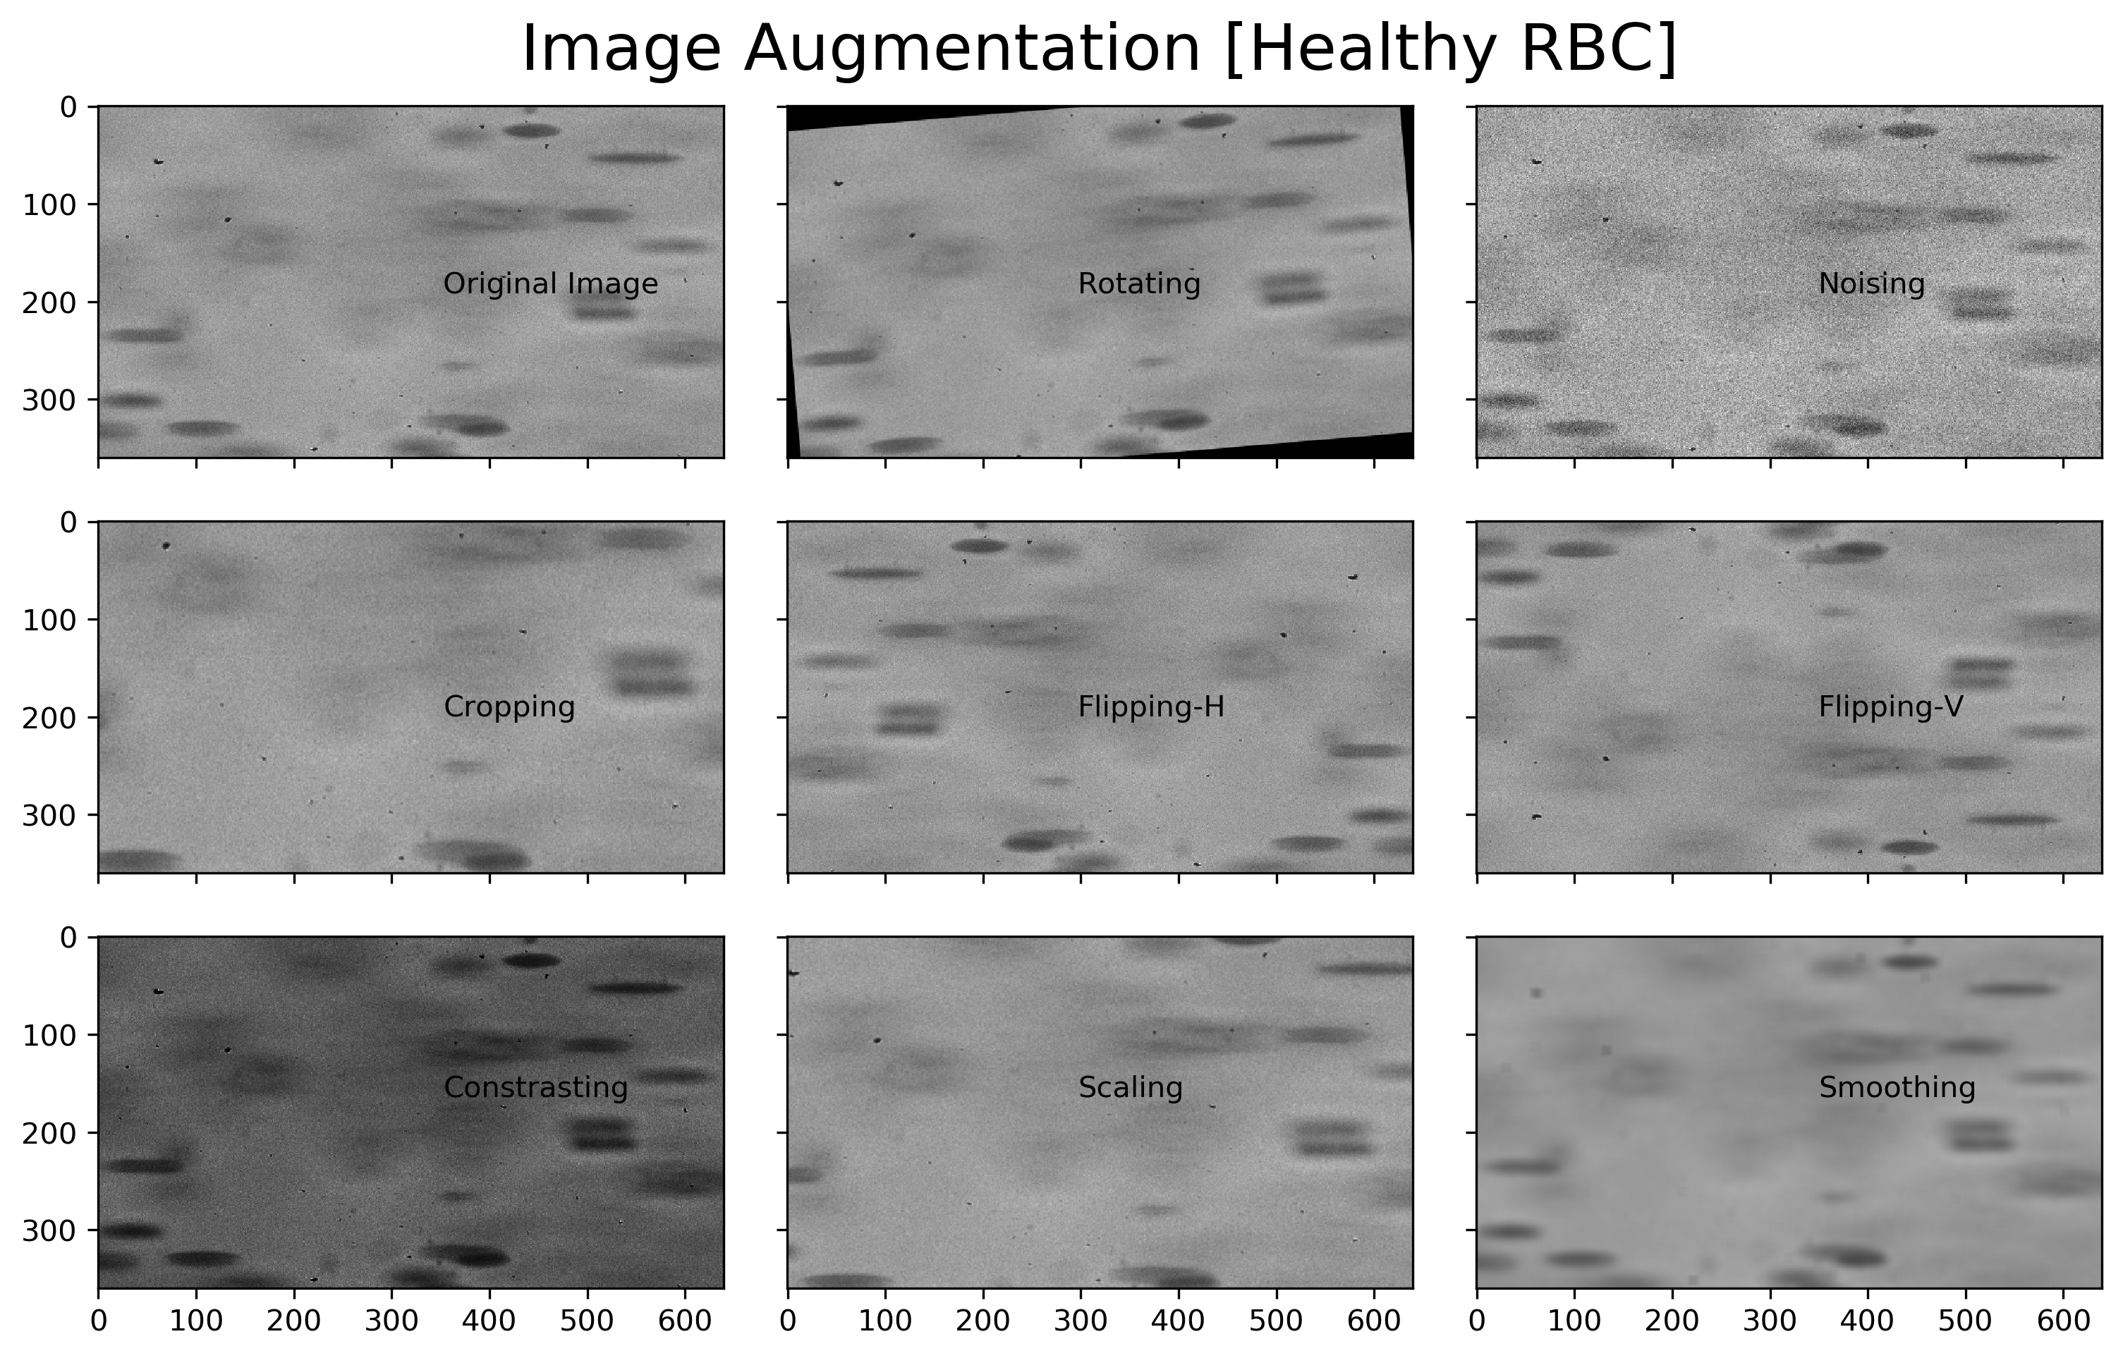
Data Augmentation
technique of applying different transformations to original images which results in multiple transformed copies of the same image
Using imgaug library

Slide 14
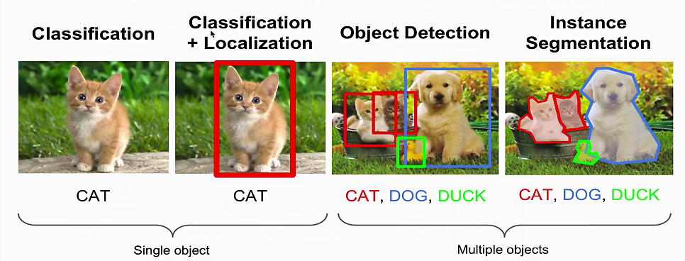
COMPUTER VISION TASKS
Notes:
Source: cs231n Localization, detection : Naver Blog

Slide 15
COMPUTER VISION TASKS
- Classification refers to labeling according to the image.
- Localization refers to boxing where the image is. When Classification and Localization are combined, boxing and labeling are performed at the same time as shown above.
- Detection is the search for multiple images within an image.
- Segmentation is the detection of the edges of specific images in an image.

Slide 16
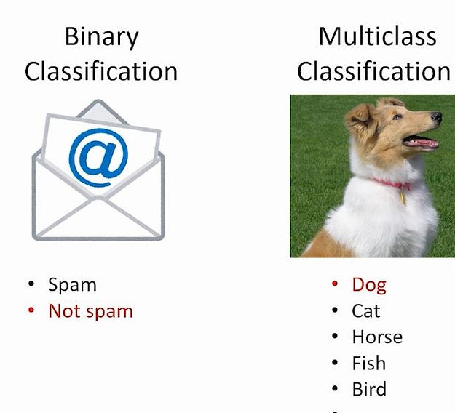
Classification (Image Classification)
Task: Assigns a label to an entire image (e.g., dog vs. cat)
Example Algorithms:
Convolutional Neural Networks (CNNs) – LeNet, AlexNet, VGG, ResNet
Vision Transformers (ViTs) – ViT, Swin Transformer
Hybrid Models – ConvNeXt (CNN + Transformer)
Pretrained Models (Transfer Learning) – ResNet, EfficientNet, MobileNet
Example Use Case: Classifying X-ray images as "Normal" or "Pneumonia."

Slide 17
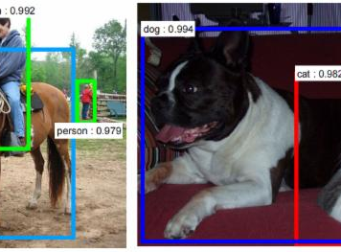
Object Detection (Bounding Box Prediction)
Task: Detects objects within an image and localizes them with bounding boxes.
Example Algorithms:
Single-Stage Detectors (Fast, Less Accurate)
YOLO (You Only Look Once) – YOLOv5, YOLOv8
SSD (Single Shot MultiBox Detector)
Two-Stage Detectors (More Accurate, Slower)
Faster R-CNN
Mask R-CNN (if segmentation is also needed)
Example Use Case: Detecting cars and pedestrians in autonomous driving.

Slide 18
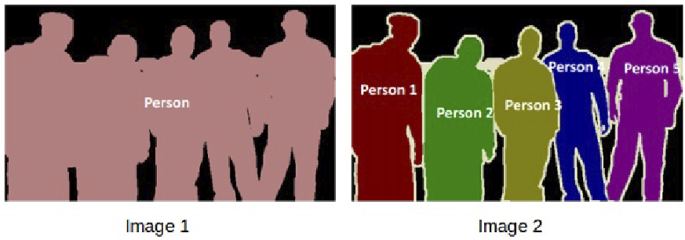
Image Segmentation (Pixel-Level Classification)
Task: Assigns a class label to each pixel in an image.
Types:
Semantic Segmentation – Classifies every pixel but doesn’t differentiate objects of the same type.
Instance Segmentation – Separates different objects of the same class.
Example Algorithms:
Fully Convolutional Networks (FCNs) – FCN-8s
U-Net (Medical Image Segmentation)
DeepLabV3+ (State-of-the-art for segmentation)
Mask R-CNN (Instance Segmentation)
Segment Anything Model (SAM) (Meta’s new AI-powered segmentation)
Example Use Case: Tumor segmentation in MRI scans.

Slide 19
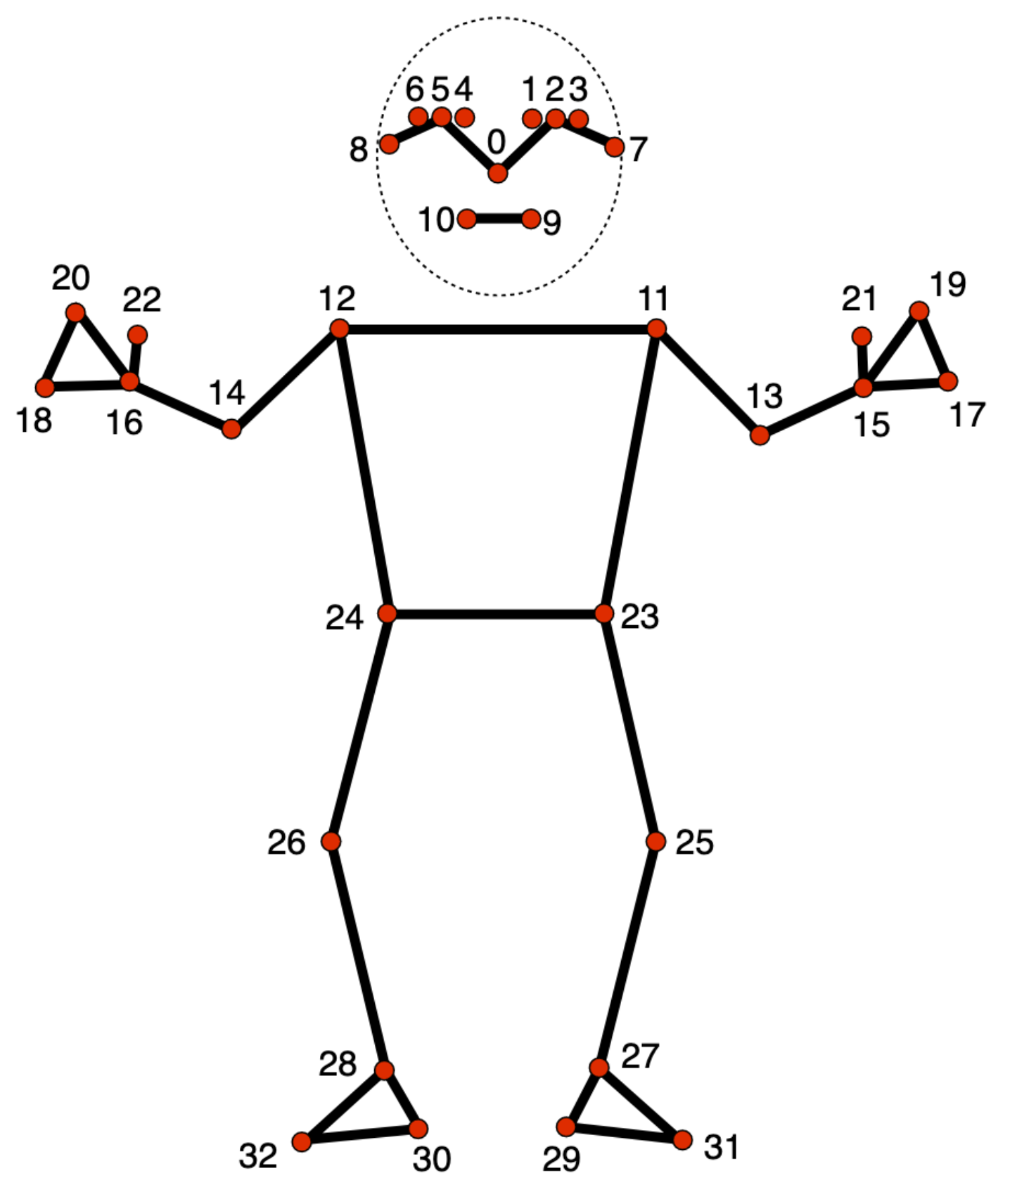
Keypoint Detection (Pose Estimation, Facial Landmarks)
Task: Detects specific points on objects, such as human joints or facial landmarks.
Example Algorithms:
OpenPose (Multi-person keypoint detection)
MediaPipe (Lightweight face and body keypoint detection)
HRNet (High-resolution keypoint detection)
PoseNet (Lightweight human pose estimation)
Example Use Case: Detecting human skeleton keypoints for fitness tracking.

Slide 20
Object Detection
Which algorithms are used for object detection tasks?
RCNN
Fast RCNN
Faster RCNN
YOLO

Slide 21
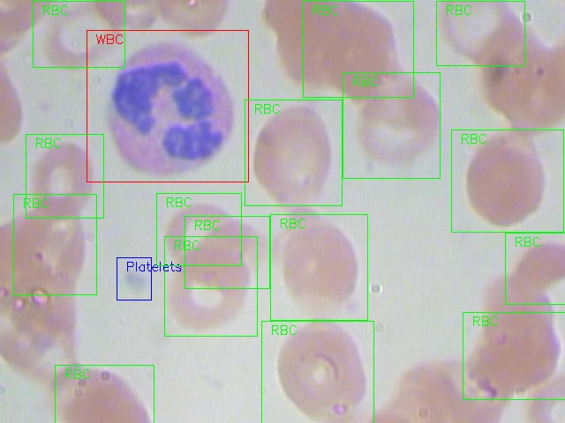
An Example
The task is to detect all the Red Blood Cells (RBCs), White Blood Cells (WBCs), and Platelets in each image taken via microscopic image readings.
a sample of what final predictions should look like:

Slide 22
Data Exploration
train_images: Images that we will be using to train the model. We have the classes and the actual bounding boxes for each class in this folder.
test_images: Images in this folder will be used to make predictions using the trained model. This set is missing the classes and the bounding boxes for these classes.
train.csv: Contains the name, class and bounding box coordinates for each image. There can be multiple rows for one image as a single image can have more than one object.

Slide 23
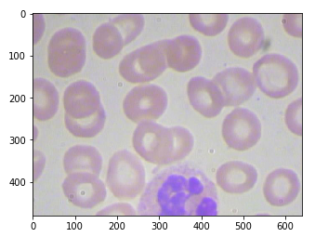
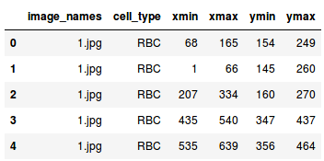
Image Annotation/labelling
Labeling images is necessary for functional datasets because it lets the training model know what the important parts of the image are (classes) so that it can later use these notes to identify those classes in new, never-before-seen images.

Slide 24
Image Annotation tools
Makesense.ai
Labelimg
labelme

